Slide 1
OSGi Development with Maven
Miquel Martin
contact@miquelmartin.org

Slide 2
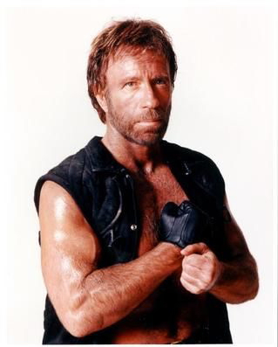


What we’ll do: The Chuck Norris Carebear impersonator
Just so we are clear
Carebear
(Funshine Bear)
Carebear
(Friend Bear)
Carebear
(CheerBear)
Not a Carebear

Slide 3
Expected End Result
Carebear Service
Carebear Service
ChuckNorris Service
Carebear Service
Wisdom
Generator
“Fear of spiders is aracnaphobia, fear of tight spaces is chlaustraphobia, fear of Chuck Norris is called Logic”
“Fear of spiders is aracnaphobia, fear of tight spaces is chlaustraphobia, fear of Funshine is called Logic”
Just prints out

Slide 4

“I’m boring” version
Carebear Service
Carebear Service
Producer
Filter
Consumer

Slide 5
OSGi basics
It’s a piece of software that runs on any Java Virtual Machine. No magic.
It is a “container” which provides APIs that:
Allow “contained” stuff (i.e. bundles) to discover each other
Dynamically add and remove bundles at runtime
Keep all bundles up to date as to what is available at any time
A bunch of OSGi services you might want to use (e.g. Logging, ConfigAdmin)

Slide 6
Why would you want to use OSGi?
It promotes modularity in your software, with bundles interacting through interfaces
It lets you dynamically change software without having to recompile and redeploy
It saves you from reimplemnting the wheel

Slide 7

What’s a bundle?
Each of the modules in your software is a bundle
A bundle has it’s own classpath, which includes:
Itself
Packages that it explicitly imports from other bundles
Bundles typically
offer one or more
“Services”.
An OSGi app is
typically a bunch of
bundles using each
other’s services
Bacon Bundle. Also, Not an OSGi Bundle.

Slide 8
Bundles: Technically speaking…
A bundle is a jar file with a special file called /META-INF/MANIFEST.MF
Manifest-Version: 1.0
Export-Package: eu.impersonator.chucknorris;version="0.0.1.SNAPSHOT"
Built-By: miquel
Build-Jdk: 1.6.0_26
Bundle-Version: 0.0.1.SNAPSHOT
Tool: Bnd-1.43.0
Bundle-Name: Chuck Norris source
Bnd-LastModified: 1312525606496
Created-By: Apache Maven Bundle Plugin
Bundle-ManifestVersion: 2
Bundle-Description: Give out Chuck Norris facts
Bundle-SymbolicName: eu.impersonator.eu.impersonator.chucknorris

